Slide 1
END-OF-LIFE CHALLENGE FOR FLEXIBLE PLASTIC PACKAGING, MULTILAYERS AND POUCHES
Dr. Terence A. Cooper
ARGO Group International
British Plastics Federation, Lunch-and-Learn
2021-05-20

Slide 2
OUTLINE
Advantages of flexible and pouch packaging over other packaging formats
Difficulties of end-of-life mechanical recycling or reuse of flexible, barrier and pouch packaging and why this is important
Environmental opposition and industry actions and responses to this to avert end-of-life challenges
Development of new and improved packaging materials, structures and recycling & recovery technologies
Conclusions, future developments and summary

Slide 3
ONGOING TRANSITION FROM RIGID TO FLEXIBLE PACKAGING
Use of flexible packaging has been increasing rapidly worldwide in market percentage and absolute terms
Flexible packaging is gaining market share from other formats such as rigid packaging in many applications
Global market $228bn 2019 projected to reach $269bn in 2024 (SmithersPira), 3.3% CAGR
Continual encroachment in FMCG areas, particularly food, beverage, pharmaceutical, previously using other packaging formats, e.g. baby food, tuna fish, pet food, motor oil, paint, often where product freshness is key.
This growth results from:
Low cost and versatility advantages to manufacturers
Continual development of new and improved flexible packaging designs and materials
Growing consumer focus on convenience

Slide 4
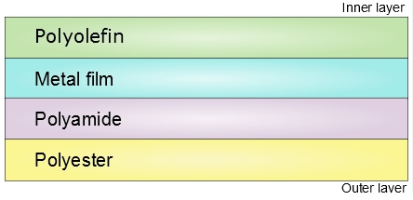
STRUCTURE OF FLEXIBLE PACKAGING
Flexible plastic packaging can have monolayer, coated monolayer or multilayer structures
The layers are different materials with specific functions and can include outer “bulk” layers, barrier layers, puncture resistance layers, tie layers & seal layers etc
These chemically-different layers and the film structure cause the difficulty in mechanical recycling

Slide 5
FLEXIBLE PACKAGING ADVANTAGES/DRIVERS
Flexible packaging is superbly designed for first- life uses: low content spoilage; long shelf life; low cost; convenience
It is replacing other formats because of its resource efficiency:
Provides equal or better functionality but uses far less materials (minimum possible to package a product), generates less waste, lower energy and transport costs
Lower environmental impact (LCA) and carbon footprint (GHG emissions) than other formats. The environmental impact of flexible packaging is much less than that of food waste
Can be tailored to specific product and size; readily printed, decorated and coded without use of separate labels; and allows instant changes
High and tunable barrier protection to O_{2,}CO₂ & moisture vapor minimizes perishable waste and increases shelf-life
Consumer convenience fits contemporary lifestyle, e.g. easy opening, resealable, portion control, zips, dispensers

Slide 6
FLEXIBLE PACKAGING NEGATIVE FACTORS
The challenge is at End-of-Life because of problems of disposal, recycling, reuse, littering and ocean pollution:
Lack of collection, sorting and recycling infrastructure, particularly for multilayer laminates and barrier packaging
Difficult to economically mechanically recycle films and multilayers, particularly post-consumer, in present MRF equipment so they are presently generally landfilled
Low bulk density so less economic incentive to recycle
Printing and frequently food residue or other contamination can amount to 10-20% of package weight
High litter visibility even though less material used
Slow environmental degradation of many materials used
These are significant problems due to consumer, NGO and governmental environmental and sustainability concerns, opposition and potential regulatory action, e.g. moves in UK, Europe, US, China to restrict, tax or ban “single-use” flexpack

Slide 7
ENVIRONMENTAL OPPOSITION
Adversarial campaigns instituted by environmental NGOs, including As You Sow, Upstream, 5 Gyres, Gaia, NRDC, Greenpeace and Sierra Club, versus food companies over pouch packaging, e.g. Kraft Capri Sun
Pressure being placed on food companies and their shareholders to set up take-back programs or stop using plastic pouch packaging altogether
NGO position: it is not acceptable to produce a product designed to be disposed of
This is based on equating sustainability with mechanical recyclability & discounting the sustainability (LCA & GHG) advantages of flexible packaging in its minimal materials, transport & energy use & reduction in perishable product waste so that it saves more resources than it uses

Slide 8
INDUSTRY ACTIONS AND RESPONSES
Industry serious about ecological challenges & actively seeking effective, economic end-of-life solutions to keep flexible packaging from landfill, litter and ocean pollution and promote use in circular economy
Include collection, identification, sorting, recycling & recovery processes & development of recyclate markets
Companies and brands are setting sustainability and recycle content goals in flexible and other packaging (Ellen MacArthur Foundation and Plastics Pact commitments and coming EPR legislation which may mandate flexible film collection)
Industry recognizes it is must further increase flexible packaging resource efficiency with improved end-of-life waste management, recycling & recovery, materials & designs. Multiple approaches under development

Slide 9
MAJOR NEW INITIATIVES AND TECHNOLOGIES FOR END-OF-LIFE PROCESSES FOR FLEXIBLE PACKAGING
Enhanced collection, identification, marking & sorting systems & mechanical recycling technologies, e.g. ACC Materials Recovery for the Future (US), CEFLEX (EU) & “Holy Grail 2.0” Digital Watermarking (EU) projects
Improved materials and designs for recyclability and development of mechanically-recyclable monomaterial structures, coated barrier systems & compatibilizers to replace present multilayer structures while still providing high barrier, puncture resistance, printability, sealability, stiffness & optics
Physical and solution recycling: delamination and selective extraction processes for multilayer films to economically separate & recover film polymers & materials and provide deinking
Chemical recycling: depolymerization to revert polymers to their monomers which are then repolymerized into new (virgin) materials
Chemical recycling: starved-oxygen and anaerobic gasification/pyrolysis & hydrothermal liquefaction processes to produce naphtha feedstocks, oils, syngas (CO + H₂), chemicals and liquid fuels

Slide 10
MATERIALS RECOVERY FOR THE FUTURE
Consortium of brand owners, packaging companies and packaging industry organizations, led by American Chemistry Council
Sponsors: Dow, Pepsico, LyondellBasell, Plum Organics, P&G, Nestle, Nestle Purina, Sealed Air, S.C. Johnson, Amcor, APR, FPA, Target, ChevronPhillips, Canadian PIA, J.P. Mascaro, Walmart, KraftHeinz, Westlake, Mondelez, Mars, J&J, Unilever and PLASTICS
Goal to increase recycling rates, divert flexible packaging from landfill and create mainstream recovery processes and systems
Resource Recycling Systems (RRS) research shows modifications of existing screening and upgraded optical sorting technology can efficiently identify & sort FPP with 74% recapture rate so far (goal to reach 90%) to provide a new recovered materials stream while improving quality of other streams, particularly the paper stream
Joint development program with J.P. Mascaro MRF in PA demonstrated technical & economic feasibility for recycling waste flexible plastic packaging from single-stream residential curbside collections and identified potential recyclate end-use markets

Slide 11
CEFLEX PROJECT (EUROPE)
Collaborative consortium project of 154+ companies and organizations representing entire European flexible packaging value chain
Developed D4ACE (Designing For a Circular Economy) guidelines for flexible packaging design & for end-of-life collection, sorting, recycling & recovery systems & infrastructure; now being implemented
Project goals by 2025:
Make flexible packaging sustainable, more valuable in the circular economy and have end-of-life value, a major challenge today, so materials can stay in CE without becoming waste or marine litter
Demonstrate sustainable, robust business case for CE for flexpack collection, sorting & recycling at competitive quality/price
Maximize overall resource efficiency of flexible packaging and optimize recyclability (mechanical, physical, chemical and other recycling types)
Establish collection, sorting and reprocessing infrastructure/economy for post-consumer flexible packaging across Europe
Ensure that flexible packaging is actually recycled and that the recyclates find sustainable end markets to replace virgin materials

Slide 12
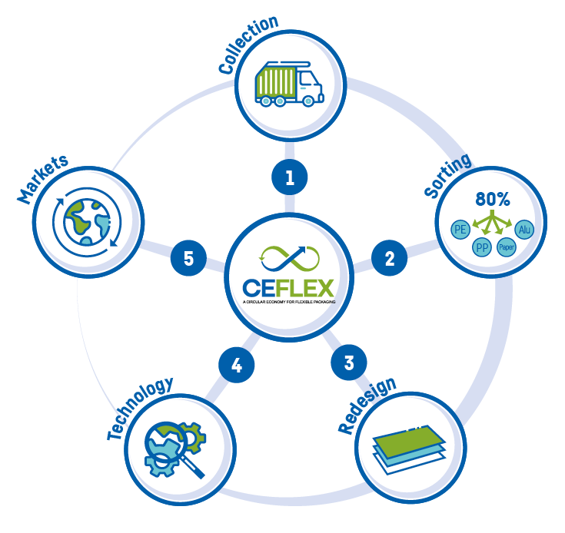
Source: CEFLEX

Slide 13
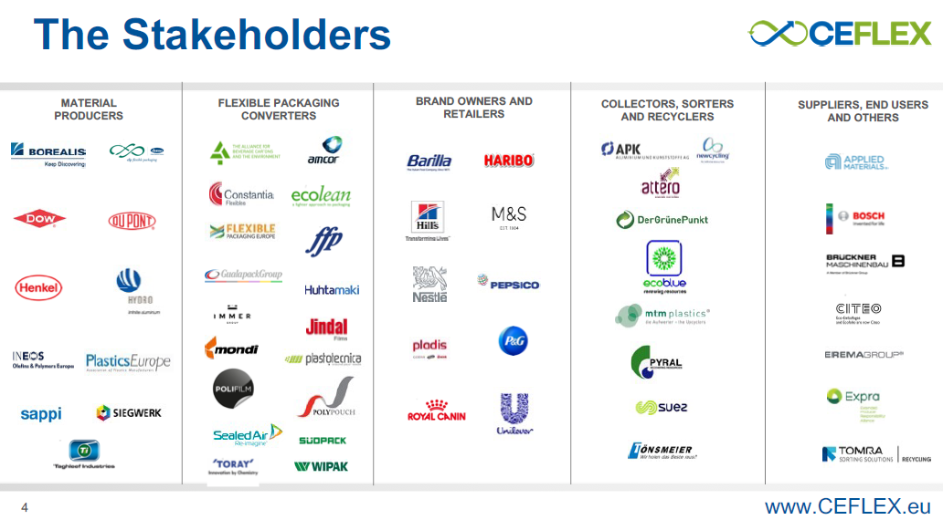

Slide 14
“HOLY GRAIL 2.0” DIGITAL WATERMARK PROJECT
Ineffective identification and sorting is a fundamental obstacle to lightweight packaging waste recycling and achieving a circular economy. Improved identification and sorting leads to more efficient mechanical recycling and higher quality recyclates
Originally began in 2016 as vs. 1.0 pilot project led by P&G in Europe & the Ellen MacArthur Foundation New Plastics Economy Projects
Following its initial success, now expanded (2019) to 120+ packaging companies and organizations led by the European Brands Association
Goal is to prove viability of digital watermarking technologies to efficiently enable packaging polymer identification, sorting and high-quality recycling in plastics waste streams at high throughput to facilitate circular economy for plastic packaging, launch an industrial pilot and demonstrate a large-scale business case
Digital watermarks are small machine-readable codes the size of a QR code but essentially invisible to the eye incorporated on packaging surfaces in multiple positions. They record detailed information about polymer types used, multilayer structure and composition, food versus non-food qualification, manufacturer, converter, SKU etc.

Slide 15
DEVELOPMENT OF SINGLE POLYMER BARRIER AND POUCH MATERIALS
Mechanically-recyclable monomaterial barrier and pouch packaging structures processable on conventional conversion and packaging equipment and complying with the Sustainable Packaging Coalition “How2Recycle” store drop-off recycling programs in the US
Cost effective all-PE or all–PP replacements for non-mechanically recyclable PET/PE and other mixed material laminates and pouches with enhanced optical properties, gloss, tensile and tear strength.
Nova Chemicals “I-Beam” structures with enhanced moisture and oxygen barrier properties acceptable for food packaging, good optical properties, higher stiffness, puncture resistance, and sealability:
(sLLDPE)/(“Surpass” HDPE)/(LLDPE)/(“Surpass” HDPE)/(C8LLDPE)
Dow “RecycleReady” technology using HDPE and “INNATE” single-site LLDPE material structures. High stiffness and toughness, more puncture- and tear-resistant than PET/PE, lower MVTR. High oxygen barrier can be incorporated with an EVOH layer
Incorporations of <5% barrier layer (EVOH, PA) or coatings (e.g. acrylics, SiOx, AlOx) is still considered monomaterial.

Slide 16
Replace Existing Structure with Store Drop-off Recyclable Film
Non-recyclable Structure
(Multi-material)
RecycleReady Structure
(Mono-material)
PET AIOx
Printability
Heat resistance, HDPE
Ink / Adhesive
High gloss and clarity, m-LLDPE
Oxygen barrier, EVOH
PE
Stiffness, moisture barrier
HDPE + Compatibilizer
Low temperature activation, zipper compatible
Hermetic seal, Affinity Plastomer
Not recyclable due to mixed materials
Designing for Recyclability
Source: DOW Designing for Recyclability
“RecycleReady”
Source

Slide 17
FULLY-RECYCLABLE ALL-PE MULTILAYER STANDUP POUCHES FOR FOOD AND NON-FOOD APPLICATIONS
Source: Dow

Slide 18
COMPATIBILIZER DEVELOPMENT TO AID RECYCLING OF OXYGEN-BARRIER FLEXIBLE PACKAGING
Compatibilizers are molecules containing different functional groups which compatibilize incompatible polymers in multilayer films and mixed plastics, increase material suitable for recycling and recyclate available for incorporation in new packaging, minimize environmental impact and reduce material landfilled
Examples are Dow Chemical “RETAIN” and Ampacet “ReVive” compatibilizers for PE/EVOH and PE/PA barrier systems. These allow barrier packaging and pouches to be mechanically recycled in a polyethylene recycling stream. EVOH systems qualified under How2Recycle store dropoff program but not yet PA systems
The compatibilizer is incorporated in an HDPE layer in the multilayer film. Upon recycling, it disperses the EVOH or PA in the PE in very small domains (below wavelength of visible light) so the PE is still transparent and can be reused (although the EVOH or PA is no longer present as a barrier layer)
Dow collaboration with Kellogg for dry food pouch packaging

Slide 19
KELLOGGS GRANOLA FULLY-RECYCLABLE ALL-PE STANDUP BARRIER POUCH
Dow/Berry Global nine-layer transparent barrier film for dry food packaging incorporating EVOH and Dow RETAIN compatibilizer. High oxygen and moisture barrier. Approved for Sustainable Packaging Coalition How2Recycle program. Source: Plastics Technology

Slide 20
FURTHER DEVELOPMENT OF SINGLE POLYMER BARRIER AND POUCH MATERIALS
Monomaterial pouches are rapidly advancing in design types and applications for frozen, dry, liquid & pet foods & household products due to consumer & brand demands for sustainable packaging
PE is currently the most widely used material for monomaterial films but use of PP is growing more rapidly. Barrier properties of both PE and PP are improved by monoaxial or biaxial orientation
New advanced monomaterial structures provide higher water vapor barrier & puncture resistance, printability, stiffness, downgaugability, lightweighting & optical properties to replace structures containing PE/PET and PE/PA. Retortable packages require all-PP designs
All-PE pouch films can be made by coextrusion or lamination and contain 3-12 layers depending on property requirements, application and packaged products. Processing is less forgiving than traditional multi-material laminates (PE/PET etc) and process equipment allowing accurate thin layer and layer-ratio process control is essential.
Monomaterial pouches must be optimized for the specific application such as size & shape, nature of packaged goods, and line conditions.

Slide 21
FURTHER DEVELOPMENT OF SINGLE POLYMER BARRIER AND POUCH MATERIALS 2
These advanced structures incorporate:
specialty high performance PE polymers such as mLLDPE and polyolefin plastomers;
oriented MDO LDPE blown film, BOPE, BOPP, cast PP; and
nucleated HDPE polymers
These films are more expensive than conventional films but with enhanced properties. For example, MDO PE structures have exceptional stiffness and clarity compared to non-oriented.
Many companies are moving into this field including:
Polymer producers: Dow, Nova, ExxonMobil, SABIC, LyondellBasell, Borealis/Borouge, SGC Chemicals
Processers and converters: Innovia, Jindal, Amcor (with Nestle), Coveris, Constantia, Bobst (with Dow), Mondi (with Jindal and Unilever), Berry Global, WIPF, PAXXUS, Taghleef and others
Film orientation machinery suppliers: Reifenhauser, Kuhne, Parkinson

Slide 22
DEVELOPMENT OF BARRIER COATINGS AND ADHESIVES TO REPLACE POLYMER LAYERS
Extremely thin (a few nm) barrier coatings, adhesives & tie layers which do not compromise mechanical recyclability, provide high O₂ barrier, & allow light-weighting and reduction in number of layers
Some examples are:
SiOx-, AlOx- and amorphous carbon-nanocoated polyolefins, polyesters & polyamides, eg Amcor Ceramis, Amlite & Toppan GL
Nanoclay composite-coated and acrylate-coated polymer films
Nano-fibrillated/nanocrystalline cellulose coatings & thin films
PVOH copolymer, polyglycolic acid and whey protein layers
High amylose hydroxypropylated starch layers
NOTE: monomaterial structures all require a collection and sorting system either curbside or by store dropoff to allow mechanical recycling and can have problems of film contamination, particularly food waste, since it is hard to get clean postconsumer film.

Slide 23
SUNBAR OXYGEN BARRIER COATING
Souce: Sun Chemical

Slide 24
PHYSICAL RECYCLING: DELAMINATION, SELECTIVE EXTRACTION AND DISSOLUTION PROCESSES
Delamination, selective extraction, de-inking and dissolution processes
Original polymer structure and energy content essentially retained
Effectively mechanical recycling with enhanced purification steps
Like mechanical recycling, there is still the challenge of collection, identification and sorting multilayer and barrier packaging in requisite volumes
These physical recycling processes are complementary, not competitive, to mechanical recycling and aimed to handle wastes which cannot be processed by mechanical recycling (e.g. multilayers and heavy contamination) or to make higher quality recyclate than mechanical recycling to develop the circular economy

Slide 25
SAPERATEC DELAMINATION PROCESS
Low-energy physical/mechanical recycling process for multilayer packaging
After initial shredding step, proprietary surfactant-based microemulsions are used to break up and separate the layers
The microemulsion is then reusable
Works with formats incorporating plastics, paper and aluminum (e.g. PE/Al, PP/Al, PE/PET)
High purity plastic components, aluminum and cellulosic fibers can be separated out for mechanical recycling and reuse
Originally developed for rigid packaging such as beverage cartons, but now extended to flexible packaging systems
Pilot plant in operation in Germany since 2014 and first large-scale recycling center (18ktpa) scheduled. Investment by Henkel October 2019

Slide 26
CADEL DEINKING
Patented technology to de-ink surface printed packaging using a solvent-free alkaline surfactant solution. Cadel seeking licensees
Removes ink from PP, PE and PET flexible packaging to produce a clear/light colored recyclate stream. Further development focusing on post-consumer packaging
100 kg/hr pilot plant in Alicante, Spain (www.cadeldeinking.com)
Works with water-based, solvent-based, UV & electron beam inks
De-inking surfactant and rinse water can be recovered, recycled and continuously reused to reduce costs and environmental impact
Cadel working to improve economics to ensure the financial benefit of producing clear or light colored recyclate compensates for the additional cost of ink removal.
Cadel has also adapted the process on a laboratory scale to separate multilayer structures for recycling and to deink non-surface printing applied between these layers

Slide 27
SELECTIVE EXTRACTION PROCESSES
APK AG “Newcycling” & Fraunhofer “CreaSolv” dissolution processes
For multilayer and mixed plastics to yield polymers with properties
close to virgin materials & with competitive economics
Polymers selectively dissolved from plastic waste with customized solvent formulations, contaminants removed and the pure polymers recovered from solution and pelletized. Used solvents recycled.
APK commercial products LDPE (Mersalen NCY) and PA (Mersamid)
PureCycle (P&G) process for polypropylene
High pressure, supercritical extraction and filtration process using alkane solvent mixtures where PP insoluble but impurities soluble
Produces recycled PP with virgin properties suitable for food contact
50Ktpa PP plant under construction in Ohio, operational 2021
Notes:
Eastman

Slide 28
CHEMICAL, ADVANCED AND MOLECULAR RECYCLING & RECOVERY PROCESSES
Emerging technologies which presently require more energy and are currently higher cost than mechanical recycling:
Depolymerization processes
Original polymers broken down into monomers which can be repolymerized to form virgin polymers
Currently applicable to polyesters (particularly PET), polystyrene and polyamides (BASF ChemCycle).
Thermal oxidative processes to produce functional chemicals
Gasification, pyrolysis, plasma pyrolysis and hydrothermal liquefaction processes
Original polymers converted to syngas (CO + H₂) or feedstocks such as naphtha and pyrolysis oils which can then be used to make new polymers, chemicals or fuels
Chemical recycling processes are complementary, not competitive, to mechanical recycling and aimed to handle wastes which cannot be processed by mechanical recycling (such as multilayers and heavy contamination) to significantly contribute to the circular economy

Slide 29
CHEMICAL, ADVANCED OR MOLECULAR RECYCLING: DEPOLYMERIZATION PROCESSES FOR POLYESTERS
Advanced circular recycling technologies for polyester waste, particularly PET, including food packaging and low-quality feedstocks such as carpet fibers not presently mechanically-recyclable. Prevents diversion of these wastes to landfill
Unlike mechanical recycling, processes work for colored, filled, dirty and food-contaminated post-consumer polyesters. No washing or sorting generally required
Polyesters converted back into parent monomers which can be repolymerized into high-quality polyester with similar properties to virgin and suitable for food contact
Currently generally high-energy high-cost processes, up to three times cost of mechanical recycling, but produce high-value recycled products from otherwise non-recyclable wastes
Notes:
Eastman

Slide 30
DEPOLYMERIZATION PROCESSES FOR POLYESTERS
IBM VOLCAT PROCESS
Inexpensive volatile organoamine nucleophilic catalyst digests PET waste at 190°C under pressure. Catalyst recovered (no waste).
Fast and selective, contaminants separated out, presently lab scale
IONIQA/UNILEVER/INDORAMA/COCA-COLA PROCESS
Catalytic PET depolymerization, 10 Ktpa industrial plant Netherlands.
EASTMAN GLYCOLYSIS AND METHANOLYSIS PROCESSES
Waste polyesters converted to monomers. Pilot plant in operation, 100 Ktpa commercial plant in 2022. Tritan Renew using 25-50% chemically recycled components now being commercialized.
LOOP INDUSTRIES/SUEZ
Claimed low energy, low temperature, no pressure depolymerization but controversial. Commercial plant projected in Europe 2023.
Gr3N DEMETO PROCESS
Fast microwave-assisted depolymerization with improved economics
CARBIOS ENZYMATIC BIORECYCLING PROCESS
High specificity enzymatic PET depolymerization (90%/10hours/72℃) Demonstration plant Lyon, France operating 2021; commercial 2025
Notes:
Eastman

Slide 31
CHEMICAL RECYCLING: NOVOLOOP PROCESS
Startup California company (www.novoloop.com)
Accelerated Thermal Oxidative Decomposition (ATODTM) recycling process for PE (HDPE, LDPE and LLDPE) involving:
Initial oxidation using dual catalyst system at 120ºC and atmospheric pressure makes low molecular weight functionalized organic species including alcohols, aldehydes, ketones and diacids
Highly active oxidation systems remove PE additives such as slip agents, antioxidants and processing aids
Produces C₂ – C₁₀ dicarboxylic acids at 90% yield based on PE. Diacid ratio is tuned by oxidant/PE ratio
Present emphasis is making high value products from diacids, particularly conversion to polyester polyols and then thermoplastic polyurethane elastomers with up to 45% recycled content
Current work is aimed at post-consumer PE film from MRFs
Eventual goal is to make this work for multilayer systems

Slide 32
CHEMICAL RECYCLING: GASIFICATION, PYROLYSIS AND HYDROTHERMAL LIQUEFACTION PROCESSES
Starved-oxygen or anaerobic thermal gasification, pyrolysis, plasma pyrolysis or hydrothermal liquefaction to produce naphtha feedstocks, pyrolysis oil, hydrocarbon waxes, syngas (H₂ + CO), which can be used to make new polymers, downstream chemical products or liquid fuels
Major application for polyolefin wastes which cannot be mechanically recycled or depolymerized to monomers
Advantage of these processes is that mixed packaging and plastics can be used (although PVC & PET are avoided). This largely averts the necessity to identify, sort and separate different types of packaging waste and no market needs to be found for a solid plastic recyclate
Disadvantage that some NGOs and consumers do not consider this true recycling and processes are controversial
IMPORTANT NOTE:
Vital to recognize that these processes are quite different from incineration (an aerobic process producing CO₂). They have low emissions and GHG footprint and yield useful chemical products which can be converted back into new materials. No dioxins are produced.

Slide 33
CHEMICAL RECYCLING: PLASTICS TO NAPHTHA FEEDSTOCKS, SYNGAS, CHEMICALS AND FUELS
Some commercial and developmental examples include:
Enerkem: Fluidized bed gasification to syngas and catalytic conversion to methanol, ethanol and downstream chemicals. 10Mtpa plant in Edmonton AB, plants planned for Quebec, Rotterdam, Spain, US, China
BA/Velocys: thermal gasification of plastic & other wastes to syngas, jet fuel & diesel. 20Mgpa jet fuel and naphtha plant 2024, Immingham UK.
Brightmark Energy: waste plastic pyrolysis to low-sulfur diesel, naphtha and waxes. Aim to source 2.4Btpa plastic scrap from Eastern US.
Plastic Energy/SABIC: Anaerobic gasification to feedstock hydrocarbon oils (Tacoil); two plants in Spain, more planned Europe and Asia
Eastman Carbon Renewal Technology: Partial oxidation to syngas then converted to methanol and acetic acid. Commercial plant Kingsport TN
Fuenix/Dow: Waste plastic pyrolyzed to naphtha, paraffins and LPG
Recycling Technologies: Thermal fluidized-bed depolymerization to low-sulfur oils & waxes. Pilot facility, Swindon, UK; commercial plant Perth
Green Mantra: Thermocatalytic depolymerization to waxes, plant in ON
Licella/Mura Technology: Catalytic hydrothermal liquefaction using supercritical water to convert waste plastics into biocrude oil. Plant under construction Teeside, UK, operational 2022. Others planned US, Germany

Slide 34
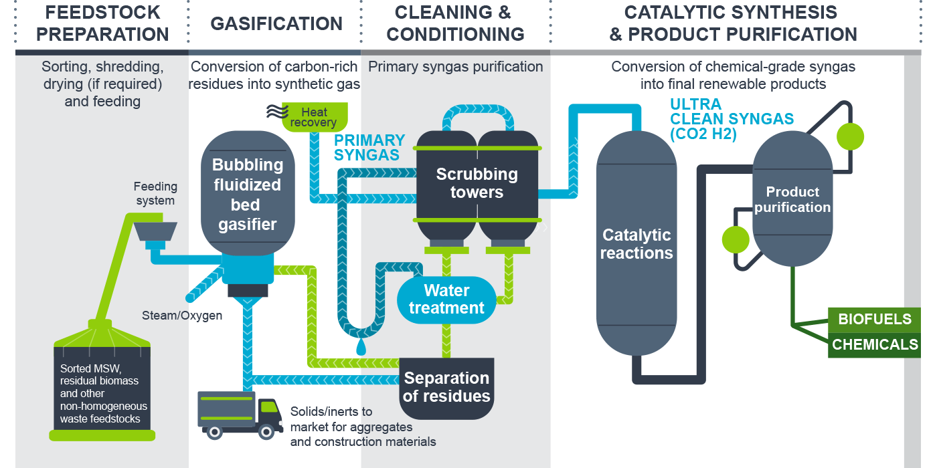
ENERKEM FLUIDIZED BED GASIFICATION PROCESS
Source: ENERKEM

Slide 35
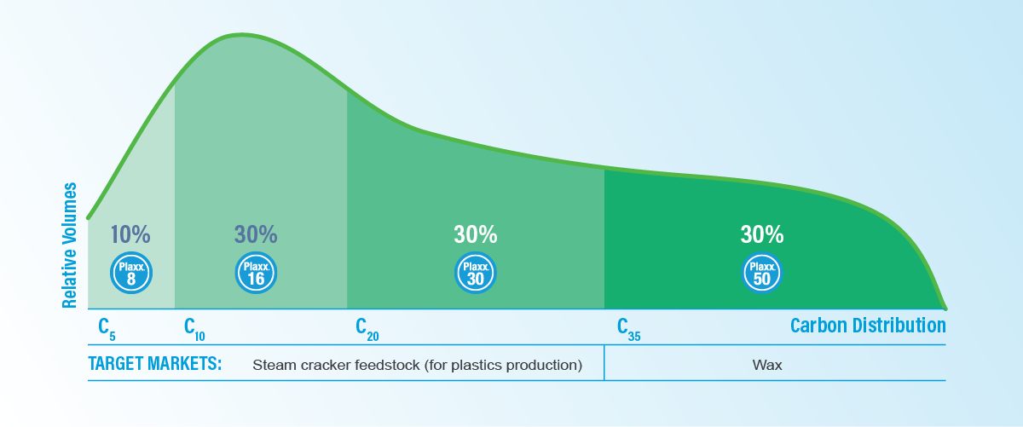
RECYCLING TECHNOLOGIES THERMAL DEPOLYMERIZATION PROCESS

Slide 36
ENVAL PROCESS
PYROLYSIS FOR ALUMINUM RECOVERY
Spin-off from Department of Engineering, Cambridge University
Provides environmentally favorable end-of-life process for complete recycling of post-consumer barrier packaging, pouches and tubes based on plastic/aluminum laminates
Construction of commercial-scale plant in Alconbury UK supported by Nestle, Kraft and Mondelez
Uses continuous anaerobic microwave-induced pyrolysis of shredded laminate over a carbon bed, at temperatures <1,000°C, to recover 100% of clean aluminum ready for reuse
Plastic components are converted to fuel gas, used to power the process, and higher alkane liquids (similar to diesel fuel)
ENVAL won UK Small and Medium Enterprise (SME) National Green Business Award for 2017
Still have challenge of collection, identification and sorting Al-based barrier packaging in requisite volumes

Slide 37
SUMMARY
Flexible packaging, particularly multilayer barrier and pouch packaging, has significant advantages and use has been expanding
Flexible packaging is resource efficient and ecologically advantageous (LCA) due to low materials and energy use, low carbon footprint and GHG emissions, and reduction in food waste
Still under attack by environmental groups because of difficulty of economic mechanical recycling so that it is presently mostly landfilled, ocean pollution & war against “single-use” packaging
The food, polymer, packaging and recycling industries are responding strongly by developing:
Improved mechanical recycling and collection, identification and sorting technologies
New materials, structures and package designs (“Design for Recyclability” and incorporation of recycled components)
New recycling and recovery technologies, including delamination, dissolution and depolymerization processes and conversion to monomers, feedstocks, chemicals and liquid fuels
Implementation of these various potential routes and processes will depend on local and national logistical, economic, social, legislative, regulatory and political situations, not just technological factors

Slide 38
THANK YOU FOR YOUR INTEREST
DR. TERENCE A. COOPER
ARGO GROUP INTERNATIONAL
US Phone: +1 302 366 8764; +1 302 420 9467
UK Phone: +44 (0) 203 286 0930
tacooper@argopolytech.com www.pcn.org/Cooper.htm
Specialist consultancy services in:
Sustainable packaging and recycling processes
Biodegradable, compostable and water-soluble plastics
Biobased and renewably-sourced plastics
Materials and formulation development and selection
Market and applications development and analysis
Member of Plastics Consultancy Network, Chemical & Industrial Consultants Association & Chemical Consultants Network

